Slide 1
Data Mining
Ch 10: Cluster Analysis - 2
Density-based Methods
  Hierarchical Methods
Wan D. Bae, Ph.D.
baewd@hanyang.ac.kr

Slide 2
Overview
Cluster Analysis Basic Concepts
Type of data in clustering analysis
Major Clustering Methods
  Partitioning Methods
  Density-Based Methods
  Hierarchical Methods
  Grid-Based Methods
Evaluation of Clustering

Slide 3
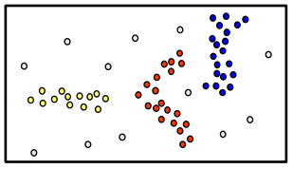
Density-Based Clustering
Basic idea
  Clusters are dense regions in the data space, separated by regions of lower object density
  A cluster is defined as a maximal set of density-connected points
  Discovers clusters of arbitrary shape

Slide 4
Density-Based Clustering Methods
Major features:
  Discover clusters of arbitrary shape
  Handle noise
  One scan
  Need density parameters as termination condition
Several interesting studies:
  DBSCAN: Ester, et al. (KDD’96)
  OPTICS: Ankerst, et al (SIGMOD’99).
  DENCLUE: Hinneburg & D. Keim (KDD’98)
  CLIQUE: Agrawal, et al. (SIGMOD’98)

Slide 5
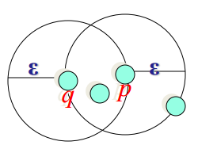
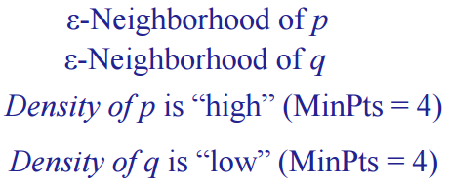
Density-Based Clustering: Basic Concepts
Two parameters:
  ε (Eps): the radius of a neighborhood
  MinPts: minimum number of objects in the neighborhood
  (the density threshold of dense regions)
The density of an object o can be measured by the number of objects close to object o
  The ε-Neighborhood of an object o : space within a radius ε centered at o : Nε(p): {q in D | dist(p, q) ≤ ε }
  “High density”: ε-Neighborhood of an object contains at least MinPts of objects
3 )
3 )

Slide 6
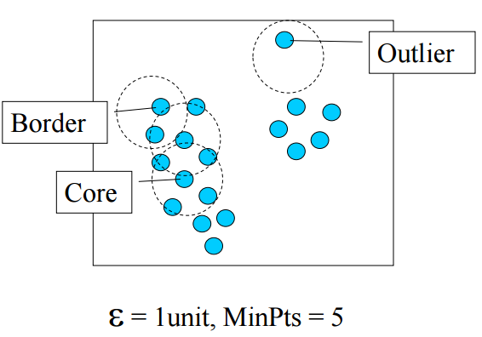
Core, Border, and Outlier
Given ε and MinPts, categorize the objects into three groups:
  A core object: its ε-neighborhood contains at least MinPts objects
    Core objects are the pillars of dense regions (at the interior of a cluster)
  A border object has fewer than MinPts within Eps, but is in the neighborhood of a core point.
  A noise object (an outlier) is any point that is not a core object nor a border object.

Slide 7
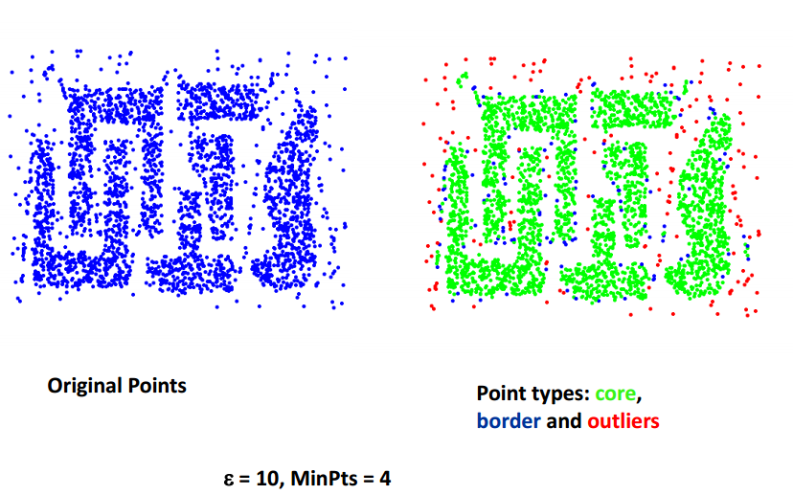
Example

Slide 8
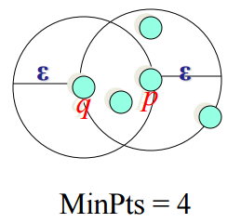
Density-reachability
Directly density-reachable:
  An object p is directly density-reachable from anther object q,
  w.r.t. Eps and MinPts iff p is in q’s ε-neighborhood
    q is a core object: |Nε (q)| ≥ MinPts
    p belongs to Nε (q)
Density-reachability is not symmetric
  q is not directly density-reachable from p
p
q

Slide 9
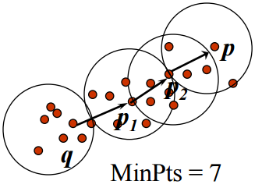
Density-Reachability
Density-reachable:
  An object p is density-reachable from another object q,
  w.r.t. Eps and MinPts iff there is a chain of points p₁, p₂ …, p_{n},
  p₁ = q and p_{n} = p such that p_{i+1} is directly density-reachable from p_{i}
  Example
    A point p is directly density-reachable from p₂
    p₂ is directly density-reachable from p₁
    p₁ is directly density-reachable from q
    p ← p₂ ← p₁ ← q form a chain
    p is (indirectly) density-reachable from q
    q is not density-reachable from p

Slide 10
Density-Connected
An object p₁ is density-connected to another object p₂, w.r.t. Eps and MinPts iff
  there is an object q such that both, p₁ and p₂ are density-reachable from q, w.r.t. Eps and MinPts
Density-connected is an equivalence relation
  Objects o₁ and o₂ are density-connected, and o₂ and o₃ are density-connected, then so are o₁ and o₃
p₁
p₂
q

Slide 11
DBSCAN: Density Based Spatial Clustering of Applications with Noise
Relies on a density-based notion of cluster: A cluster is defined as a maximal set of density-connected points
Discovers clusters of arbitrary shape in spatial databases with noise
Given a set D of objects, we identify all core objects w.r.t. the given parameters, ε (Eps) and MinPts.
  Using core objects and their neighborhoods, we then form dense regions, where the dense regions are clusters
  Using the directly density-reachable relation, a core object can “bring” all objects from its ε-neighborhood into a dense region.
  To connect core objects as well as their neighbors in a dense region DBSCAN uses “density-connected”

Slide 12
DBSCAN: The Algorithm
Arbitrary select an object o in D, if o is not processed;
  If o is a core point ( |Nε (o)| ≥ MinPts ), a cluster is formed
    Collect all objects density-reachable from o, w.r.t. Eps and MinPts
    (DBSCAN iteratively collects directly density-reachable objects)
    Merge of a few density-reachable clusters may occur
  If o is not a core object ( |Nε (o)| < MinPts ), o is considered to be noise and not added to any cluster.
    If this is not density-reachable from any core point, it stays as noise.
    If it is a border object, no objects are density-reachable from o and DBSCAN visits the next object of the database
Continue the process until all of the objects have been processed

Slide 13
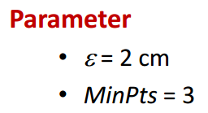
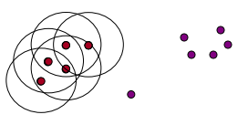
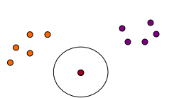
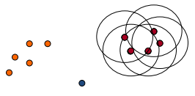
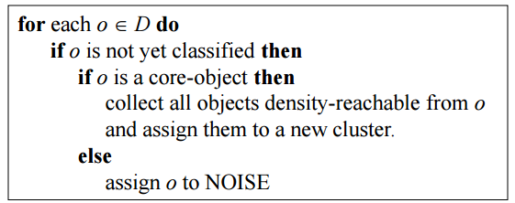
DBSCAN Algorithm: Example

Slide 14
Algorithm
DBSCAN(D, eps, MinPts)
C = 0
for each unvisited point P in dataset D
mark P as visited
N = regionQuery(P, eps)
if sizeof(N) < MinPts
mark P as NOISE
else
C = next cluster
expandCluster(P, N, C, eps, MinPts)
expandCluster(P,N,C,eps,MinPts)
add P to cluster C
for each point P' in N
if P' is not visited
mark P' as visited
N' = regionQuery(P', eps)
if sizeof(N') >= MinPts
N = N joined with N'
if P' is not yet member of any cluster
add P' to cluster C
Complexity with indexing structure: O(n*log(n))

Slide 15



DBSCAN: Sensitive to Parameters

Slide 16
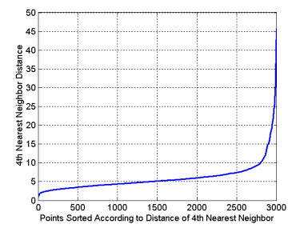
DBSCAN: Determining Eps and MinPts
Idea is that for objects in a cluster, their k^{th} nearest neighbors (this k doesn’t mean the same as k clusters, so you can say this is something p^{th} nearest neighbors) are at roughly the same distance
Noise points have the k^{th} nearest neighbor at farther distance
So, plot sorted distance of every point to its k^{th} nearest neighbor

Slide 17
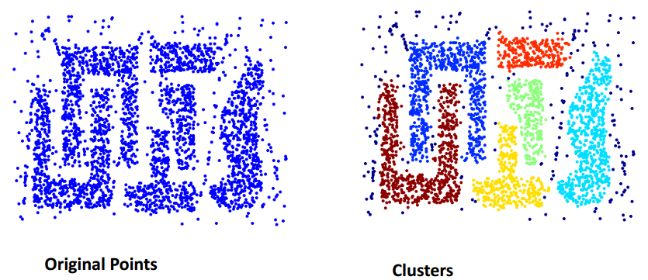
When DBSCAN Works Well
Resistant to noise
Can handle clusters of different shapes and sizes

Slide 18
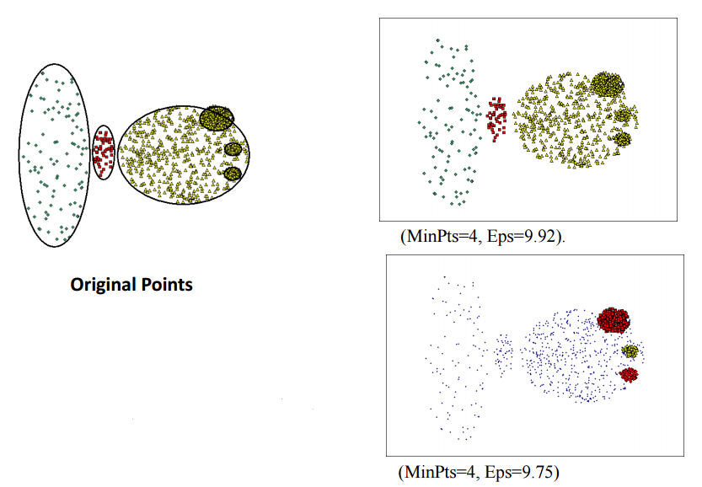
When DBSCAN Does Not Works Well
Cannot handle varying densities
Sensitive to parameters—hard to
determine the correct set of parameters

Slide 19
Hierarchical Clustering
Use distance matrix as clustering criteria. This method does not require the number of clusters k as an input, but needs a termination condition
Step 0
Step 1
Step 2
Step 3
Step 4
agglomerative
(AGNES)
a
a b
  Merge nodes that have the least dissimilarity
b
a b c d e
c
c d e
d
d e
e
divisive
(DIANA)
Step 4
Step 3
Step 2
Step 1
Step 0
Notes:
Works by grouping objects into tree of clusters

Slide 20

AGNES (AGglomerative NESting)
Use the Single-Link method and the dissimilarity matrix
  Single linkage: C1 and C2 are merged if an object in C1 and an object in C2 form minimum Euclidean distance between any two objects from different clusters
  Merge nodes that have the least dissimilarity
Eventually all nodes belong to the same cluster
Notes:
Single linkage: C1 and C2 are merged if an object in C1 and an object in C2 form minimum Euclidean distance between any two objects from different clusters

Slide 21
How the Clusters are Merged Hierarchically
A dendrogram: decompose data objects into several levels of nested partitioning (tree of clusters)
A clustering of the data objects is obtained by cutting the dendrogram at the desired level, then each connected component forms a cluster
Level 1
Level 2
Level 3
Level 4
Level 5

Slide 22
DIANA (Divisive Analysis)
Inverse order of AGNES
Eventually each node forms a cluster on its own

Slide 23
More on Hierarchical Clustering Methods
Major weakness of agglomerative clustering methods
  Do not scale well: time complexity of at least O(n²), where n is the number of total objects
  Can never undo what was done previously
Integration of hierarchical with distance-based clustering
  BIRCH: uses CF-tree and incrementally adjusts the quality of sub-clusters (Zhang, Ramakrishnan & Livny, SIGMOD’96)
  CHAMELEON: hierarchical clustering using dynamic modeling (CHAMELEON: G. Karypis, E. H. Han, and V. Kumar, 1999)

Slide 24
BIRCH (Balanced Iterative Reducing and Clustering Using Hierarchies)
Incrementally construct a Clustering Feature tree (CF tree), a hierarchical data structure for multiphase clustering
  Phase 1: scan DB to build an initial in-memory CF tree
    CF tree: a multi-level compression of the data that tries to preserve the inherent clustering structure of the data
  Phase 2: use an arbitrary clustering algorithm to cluster the leaf nodes of the CF-tree
Advantages:
  Scales linearly: finds a good clustering with a single scan and improves the quality with a few additional scans
  Ability to incrementally and dynamically cluster incoming
Weakness: handles only numeric data, and sensitive to the order of the data record

Slide 25
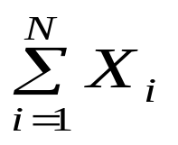
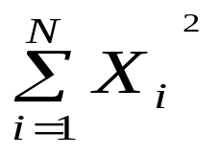
Clustering Feature Vector in BIRCH
Clustering feature:
  Summary of the statistics for a given subcluster
  the 0th, 1st, and 2nd moments of the subcluster from the statistical point of view
  Registers crucial measurements for computing cluster and utilizes storage efficiently
CF = (5, (16,30),(54,190))
Clustering Feature (CF): CF = (N, LS, SS)
N: Number of data points
LS: linear sum of N points:
SS: square sum of N points:
(3,4)
(2,6)
(4,5)
(4,7)
(3,8)

Slide 26

The CF Tree Structure
Root
A CF tree has two parameters
  Branching factor: max # of children
  Threshold: max diameter of sub-clusters stored at the leaf nodes
B = 7
L = 6
CF₁
CF₂
CF₃
CF₆
child₁
child₂
child₃
child₆
Non-leaf node
CF₁
CF₂
CF₃
CF₅
child₁
child₂
child₃
child₅
Leaf node
Leaf node
prev
CF₁
CF₂
CF₆
next
prev
CF₁
CF₂
CF₄
next
A CF tree is a height-balanced tree
  The nonleaf nodes store sums of the CFs of their children

Slide 27
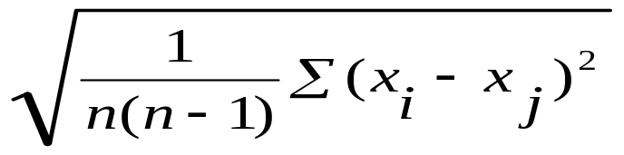
The Birch Algorithm
Cluster Diameter: square root of average mean squared distance between all pairs of points in the cluster
For each point in the input
  Find closest leaf entry
  Add point to leaf entry and update CF
  If entry diameter > max_diameter, then split leaf, and possibly parents
Algorithm is O(n)
Concerns
  Sensitive to insertion order of data points
  Since we fix the size of leaf nodes, so clusters may not be so natural
  Clusters tend to be spherical given the radius and diameter measures

Slide 28
CHAMELEON: Hierarchical Clustering Using Dynamic Modeling
Measures the similarity based on a dynamic model
  Two clusters are merged only if the interconnectivity and closeness (proximity) between two clusters are high
  relative to the internal interconnectivity of the clusters and closeness of items within the clusters
Graph-based, and a two-phase algorithm
  Use a graph-partitioning algorithm: cluster objects into a large number of relatively small sub-clusters
  Use an agglomerative hierarchical clustering algorithm: find the genuine clusters by repeatedly combining these sub-clusters

Slide 29
Overall Framework of CHAMELEON
Construct (K-NN)
Sparse Graph
Partition the Graph
Data Set
a graph-partitioning algorithm
K-NN Graph
  P and q are connected if q is among the top k closest neighbors of p
Merge Partition
Relative interconnectivity: connectivity of c₁ and c₂ over internal connectivity
Relative closeness: closeness of c₁ and c₂ over internal closeness
Final Clusters

Slide 30
Constructing a sparse graph
Using KNN
  Data points that are far away are completely avoided by the algorithm (reducing the noise in the dataset)‏
  Captures the concept of neighbourhood dynamically by taking into account the density of the region.
Partition the KNN graph such that the edge cut is minimized
  Reason: Since edge cut represents similarity between the points, less edge cut => less similarity.
represents similarity between the points, less edge cut => less similarity.

Slide 31
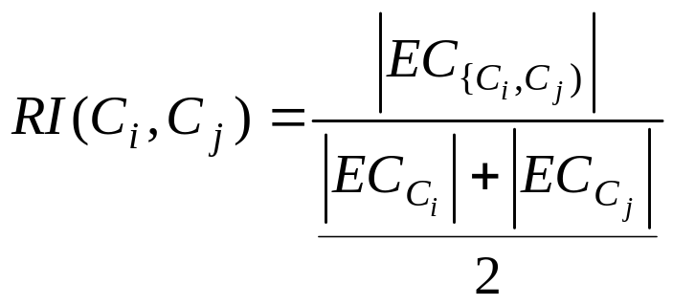
Relative Inter-Connectivity
The absolute inter-connectivity between Ci and Cj normalized with respect to the internal inter-connectivity of the two clusters Ci and Cj
  EC (Ci,Cj) : sum of weights of edges that connect Ci with Cj
  EC_{Ci} , EC_{Cj} : weighted sum of edges that partition the cluster into roughly equal parts

Slide 32
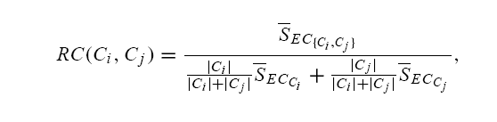
Relative Closeness
Absolute closeness normalized with respect to the internal closeness of the two clusters.
  Absolute closeness got by average similarity between the points in Ci that are connected to the points in Cj :
  average weight of the edges from C(i)->C(j)
  Internal closeness of the cluster got by average of the weights of the edges in the cluster

Slide 33

Which clusters do we merge?
So far, we have got
  Relative Inter-Connectivity measure
  Relative Closeness measure
Using them,
If the relative inter-connectivity measure relative closeness measure are same, choose inter-connectivity.

Slide 34

CHAMELEON (Clustering Complex Objects)

Slide 35

Grid-Based Clustering Method
Using multi-resolution grid data structure
STING: a statistical information grid approach
  Wang, Yang and Muntz (VLDB’97)
  The spatial area is divided into rectangular cells
  Each cell at a high level is partitioned into a number of smaller cells in the next lower level

Slide 36
The STING Clustering Method
Preprocessing:
  Statistical information of each cell is calculated and stored beforehand and is used to answer queries
Parameters of higher level cells can be easily calculated from parameters of lower level cell
  count, mean, standard deviation, min, max
  type of distribution—normal, uniform, etc.
Use a top-down approach to answer spatial data queries
  Remove the irrelevant cells from further consideration
  When finish examining the current layer, proceed to the next lower level
  Repeat this process until the bottom layer is reached

Slide 37
STING Analysis
Advantages:
  Query-independent, easy to parallelize, incremental update
  O(k), where k is the number of grid cells at the lowest level
Disadvantages:
  All the cluster boundaries are either horizontal or vertical, and no diagonal boundary is detected

Slide 38
Grid-Based Clustering Method
CLIQUE: Clustering in quest
  Agrawal, Gehrke, Gunopulos, Raghavan (SIGMOD’98)
  Automatically identifying subspaces of a high dimensional data space that allow better clustering than original space
  both grid-based and density-based
Algorithm
  It partitions each dimension into the same number of equal length interval
  It partitions an m-dimensional data space into non-overlapping rectangular units
  A unit is dense if the fraction of total data points contained in the unit exceeds the input model parameter
  A cluster is a maximal set of connected dense units within a subspace

Slide 39
CLIQUE: The Major Steps
Partition the data space and find the number of points that lie inside each cell of the partition.
Identify the subspaces that contain clusters using the Apriori principle
Identify clusters
  Determine dense units in all subspaces of interests
  Determine connected dense units in all subspaces of interests
Generate minimal description for the clusters
  Determine maximal regions that cover a cluster of connected dense units for each cluster
  Determination of minimal cover for each cluster

Slide 40
Salary (10,000)
Vacation(week)
7
7
6
6
5
5
4
4
3
3
2
2
1
1
0
age
0
age
20
30
40
50
60
20
30
40
50
60
τ = 3
Vacation
Salary
30
50
age

Slide 41
CLIQUE Analysis
Strength
  Insensitive to the order of records in input and does not presume some canonical data distribution
  Scales linearly with the size of input and has good scalability as the number of dimensions in the data increases
Weakness
  The accuracy of the clustering result may be degraded at the expense of simplicity of the method

